Slide 1

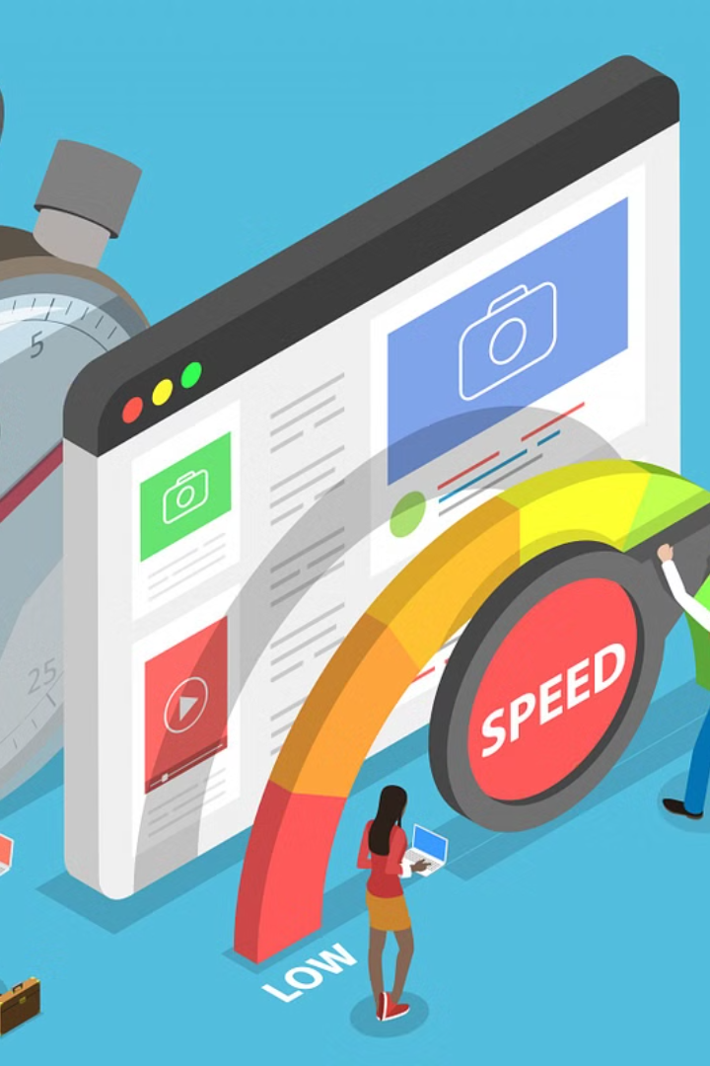
Elite Solutions Website
Elite Solutions is revamping its website to overcome the challenges of slow loading times. The current website, built with HTML, CSS, JavaScript, and React, is being upgraded to ensure optimal performance and user experience.
The new website aims to showcase elite solutions for various industries, providing a seamless and efficient platform for clients.

Slide 2

Current issues with the old website
Slow Loading Times: Pages take too long to load, leading to poor user experience.
Outdated Design: The layout and visual elements feel antiquated and do not reflect modern standards.
Unresponsive UI: Lack of responsiveness on different devices affects usability.

Slide 3
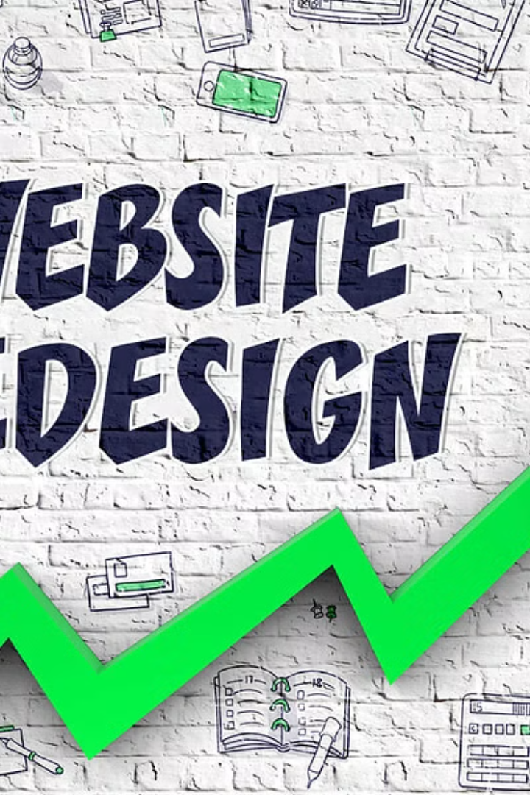
The Need for a Redesign
As technology evolves, user expectations shift, and competition increases, the old website's design no longer meets current industry standards. A redesign is necessary to align with modern user preferences and improve performance. Additionally, the current design may not be responsive or mobile-friendly, impacting user experience.

Slide 4
Technologies Used in the Old Website
HTML
CSS
HTML (Hypertext Markup Language) was used to create the structure and content of the old website.
CSS (Cascading Style Sheets) was employed to define the visual presentation and layout of the website.
JavaScript
React
JavaScript was utilized for adding interactivity and dynamic features to the website.
React, a popular JavaScript library, was integrated for building user interfaces and managing the website's state.

Slide 5
Advantages of HTML, CSS, JS, and React
HTML
CSS
JavaScript
React
HTML provides the structure for web pages, allowing for the organization of content and creation of links.
CSS enhances the visual appeal of websites, allowing for customized styles, layouts, and design elements.
JavaScript adds dynamic functionality to websites, enabling interactive elements and user-engagement.
React is a powerful library for building user interfaces, promoting code reusability and modular development.
It contributes to the creation of modern, feature-rich web applications.
It enhances performance and enables the creation of scalable and efficient web applications.
It forms the backbone of any website, helping in the accessibility and understanding of content.
It also enables responsive design, ensuring a seamless viewing experience across devices.

Slide 6

Design considerations for the new website
1
User-Focused Design
The new website will prioritize user experience with intuitive navigation and visually pleasing layout.
2
Mobile Responsiveness
Ensuring seamless browsing and interaction on devices of all sizes for a modern user base.
3
Accessibility & Inclusivity
Implementing features that cater to users with disabilities and diverse needs for equal access.

Slide 7
Key features and functionality of the new website
Responsive Design
Interactive Elements
The new website will have a responsive design to ensure optimal viewing experience across various devices.
Interactive elements such as buttons, forms, and sliders will enhance user engagement.
Seamless Navigation
Integration with Social Media
Intuitive navigation will enable users to find information easily and access key sections effortlessly.
Social media integration will facilitate easy sharing of content and interaction with the audience.

Slide 8

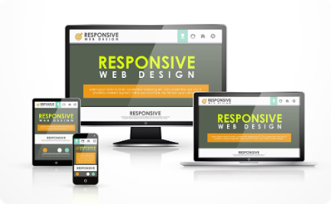

User experience improvements
User-Friendly Design
Responsive Layouts
Accessibility Features
We focus on intuitive navigation and user interface to enhance user satisfaction.
Our websites are designed to adapt seamlessly to various devices for a consistent user experience.
Implementing accessibility best practices to ensure inclusivity and usability for all users.

Slide 9
Performance enhancements with the new technologies
50%
60%
Improved Speed
Reduced Latency
Utilizing the latest technologies has led to a 50% improvement in website loading speed.
The implementation of modern frameworks has resulted in a 60% reduction in latency.

Slide 10

Conclusion and Next Steps
As we conclude, the next steps for Elite Solutions involve implementing the new technologies, enhancing user experience, and optimizing website performance. The redesign process will focus on incorporating HTML, CSS, JavaScript, and React to create a modern, responsive, and efficient website.

